Slide 1

SunShot
2030 Waterfalls

Slide 2
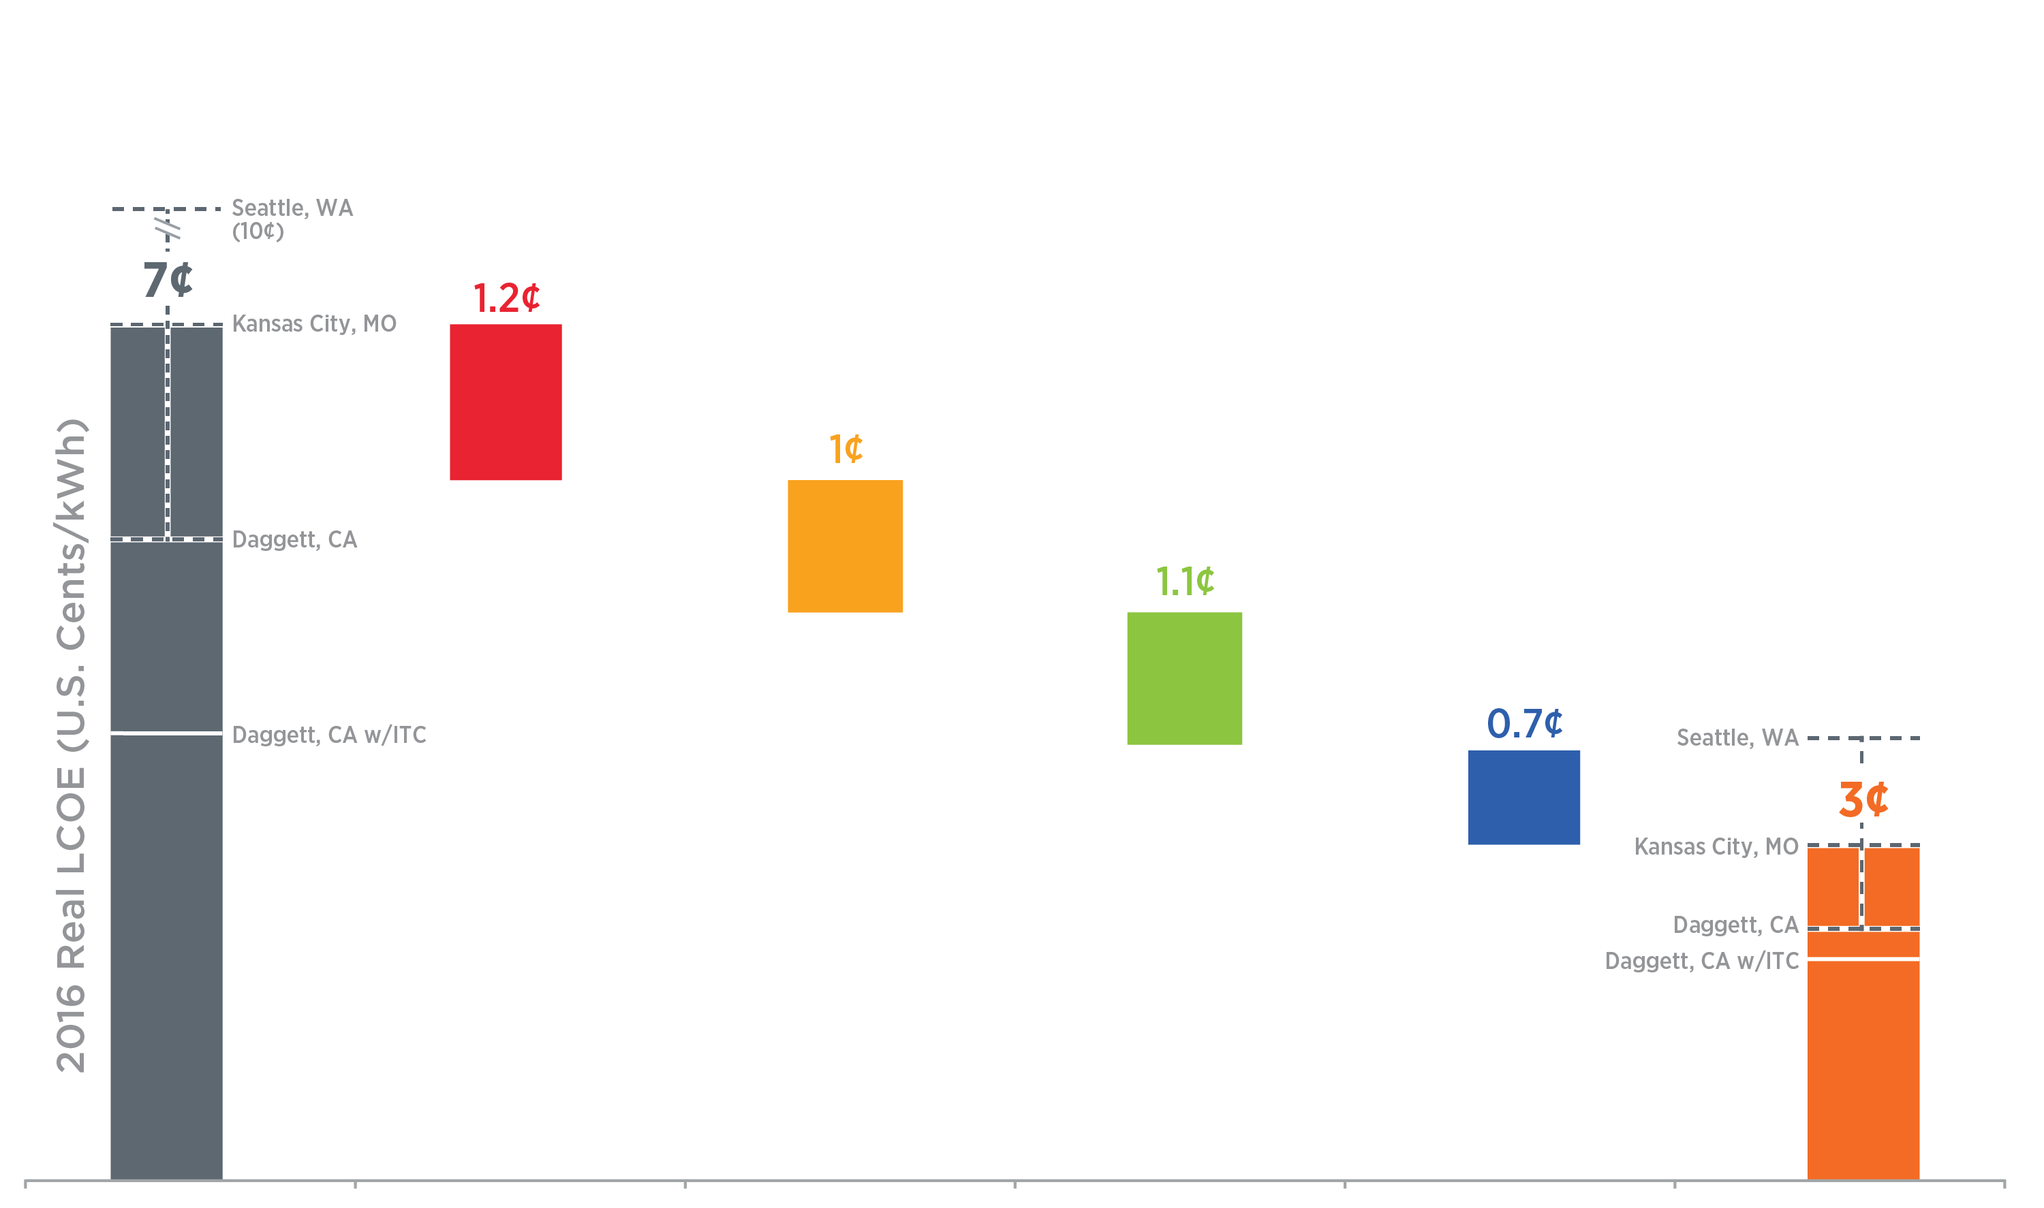
A Pathway To 3 Cents per kWh
Improve efficiency while decreasing cost. Example 1: Further reduction of impurities and defects in multicrystalline material. Example 2: Improved screen-print metal pastes. Example 3: Lowering manufacturing CapEx by kerfless wafering.
2016
Benchmark
Lower Sustainable Module Price:
$0.65 to $0.30/W
Lower Balance of System Hardware and Soft Costs
$0.85 to $0.55/W
Improve Lifetime:
30 to 50 years
and Lower Degradation Rate:
0.75% to 0.2% /year
Lower O&M:
$14 to
$4/kW-yr
SunShot 2030
Goal
100 MW_{(DC)} One-Axis Tracking Systems With 1,860 kWh_{(AC)}/kW_{(DC)} First-Year Performance.
Includes 5 Year MACRS. Cost of capital is 7% and inflation is 2.5%.
Notes:
Although these targets are aggressive, multiple pathways toward achieving them are possible. Here we show one potential route, which relies on significant improvements in module price and efficiency, system reliability, O&M costs, hardware and labor costs, and financing rates. However, the numerous interdependencies and tradeoffs among cost- and performance-improvement factors create numerous potential approaches—all of which require sustained, multifaceted innovation.

Slide 3
A Pathway To 3 Cents per kWh
Every balance-of-system hardware component’s cost can be reduced. Example 1: Identification of materials that can withstand higher system voltage. Example 2: Higher-frequency inverters.
Labor costs can be reduced by speeding up every step in the process. Example 1: Standardization across jurisdictions accelerates permitting. Example 2: Self-configuring module electronics reduce installation time.
2016
Benchmark
Lower Sustainable Module Price:
$0.65 to $0.30/W
Lower Balance of System Hardware and Soft Costs
$0.85 to $0.55/W
Improve Lifetime:
30 to 50 years
and Lower Degradation Rate:
0.75% to 0.2% /year
Lower O&M:
$14 to
$4/kW-yr
SunShot 2030
Goal
100 MW_{(DC)} One-Axis Tracking Systems With 1,860 kWh_{(AC)}/kW_{(DC)} First-Year Performance.
Includes 5 Year MACRS. Cost of capital is 7% and inflation is 2.5%.
Notes:
Although these targets are aggressive, multiple pathways toward achieving them are possible. Here we show one potential route, which relies on significant improvements in module price and efficiency, system reliability, O&M costs, hardware and labor costs, and financing rates. However, the numerous interdependencies and tradeoffs among cost- and performance-improvement factors create numerous potential approaches—all of which require sustained, multifaceted innovation.

Slide 4
A Pathway To 3 Cents per kWh
Improve upon today’s best-in-class reliability in low-cost modules. Example 1: Glass polymer modules can transition to more durable glass-glass module construction. Example 2: New accelerated testing methods to provide rapid feedback to guide improvements in module durability.
2016
Benchmark
Lower Sustainable Module Price:
$0.65 to $0.30/W
Lower Balance of System Hardware and Soft Costs
$0.85 to $0.55/W
Improve Lifetime:
30 to 50 years
and Lower Degradation Rate:
0.75% to 0.2% /year
Lower O&M:
$14 to
$4/kW-yr
SunShot 2030
Goal
100 MW_{(DC)} One-Axis Tracking Systems With 1,860 kWh_{(AC)}/kW_{(DC)} First-Year Performance.
Includes 5 Year MACRS. Cost of capital is 7% and inflation is 2.5%.
Notes:
Although these targets are aggressive, multiple pathways toward achieving them are possible. Here we show one potential route, which relies on significant improvements in module price and efficiency, system reliability, O&M costs, hardware and labor costs, and financing rates. However, the numerous interdependencies and tradeoffs among cost- and performance-improvement factors create numerous potential approaches—all of which require sustained, multifaceted innovation.

Slide 5
A Pathway To 3 Cents per kWh
O&M cost can be reduced by automation. Example 1: Automated field inspection by thermal and electroluminescence imaging. Example 2: Automated panel cleaning.
2016
Benchmark
Lower Sustainable Module Price:
$0.65 to $0.30/W
Lower Balance of System Hardware and Soft Costs
$0.85 to $0.55/W
Improve Lifetime:
30 to 50 years
and Lower Degradation Rate:
0.75% to 0.2% /year
Lower O&M:
$14 to
$4/kW-yr
SunShot 2030
Goal
100 MW_{(DC)} One-Axis Tracking Systems With 1,860 kWh_{(AC)}/kW_{(DC)} First-Year Performance.
Includes 5 Year MACRS. Cost of capital is 7% and inflation is 2.5%.
Notes:
Although these targets are aggressive, multiple pathways toward achieving them are possible. Here we show one potential route, which relies on significant improvements in module price and efficiency, system reliability, O&M costs, hardware and labor costs, and financing rates. However, the numerous interdependencies and tradeoffs among cost- and performance-improvement factors create numerous potential approaches—all of which require sustained, multifaceted innovation.

Slide 6
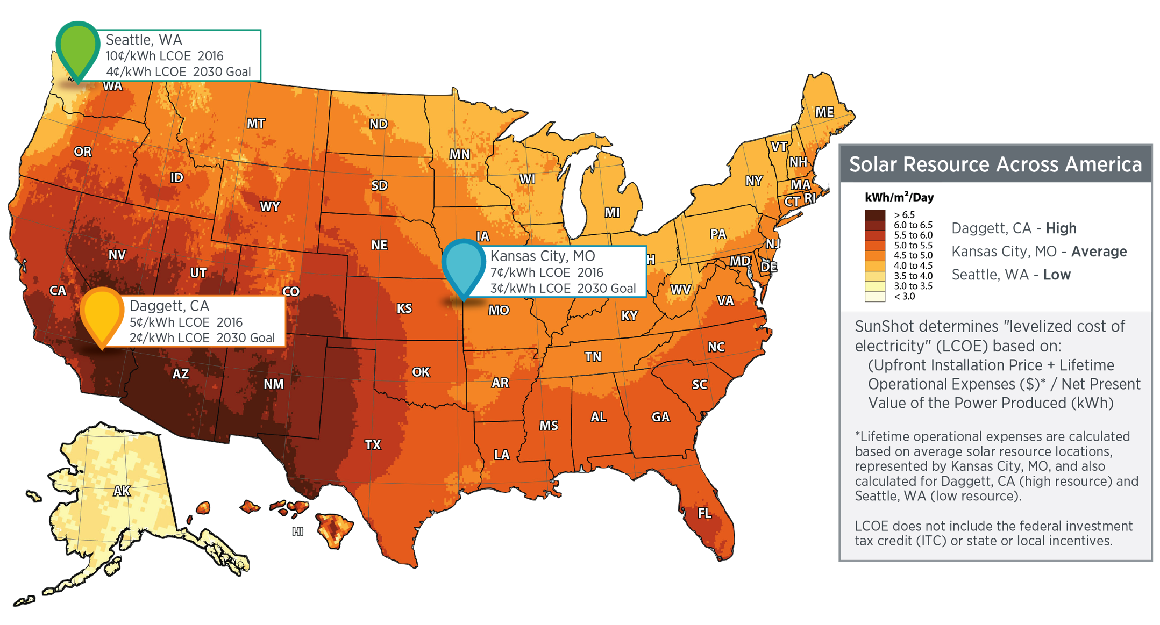
Average Solar Resource Calculation
The amount of power that is produced by a PV system depends upon the solar resource availability (in addition to other factors like temperature and snowfall), which is location dependent. The median solar resource for the United States is represented by Kansas City, MO, while the highest solar resource is represented by Daggett, CA, and the lowest solar resource is represented by Seattle, WA.

Slide 7
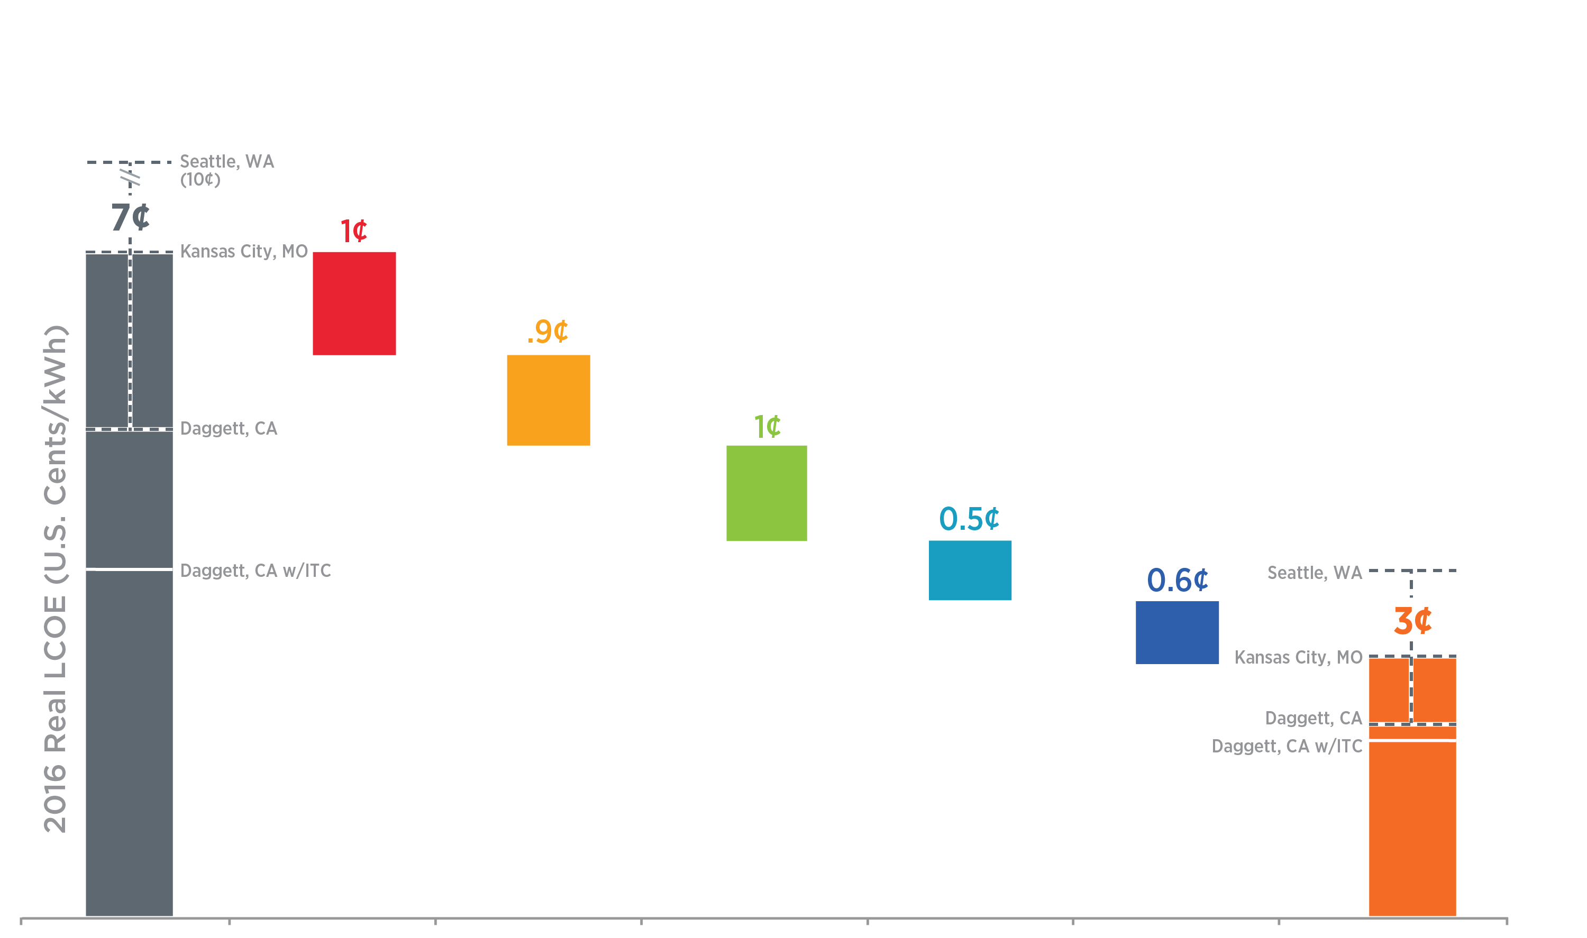
Another Pathway To 3 Cents per kWh
0.9¢
2016
Benchmark
Lower Sustainable Module Price:
$0.65 to $0.35/W
Lower Balance of System Hardware and Soft Costs
$0.85 to $0.60/W
Improve Lifetime:
30 to 50 years
and Lower Degradation Rate:
0.75% to 0.2% /year
Lower O&M:
$14 to
$4/kW-yr
Lower Cost of Capital:
7.0% to 6.0%
SunShot 2030
Goal
100 MW_{(DC)} One-Axis Tracking Systems With 1,860 kWh_{(AC)}/kW_{(DC)} First-Year Performance.
Includes 5 Year MACRS.
Notes:
Although these targets are aggressive, multiple pathways toward achieving them are possible. Here we show one potential route, which relies on significant improvements in module price and efficiency, system reliability, O&M costs, hardware and labor costs, and financing rates. However, the numerous interdependencies and tradeoffs among cost- and performance-improvement factors create numerous potential approaches—all of which require sustained, multifaceted innovation.

Slide 8
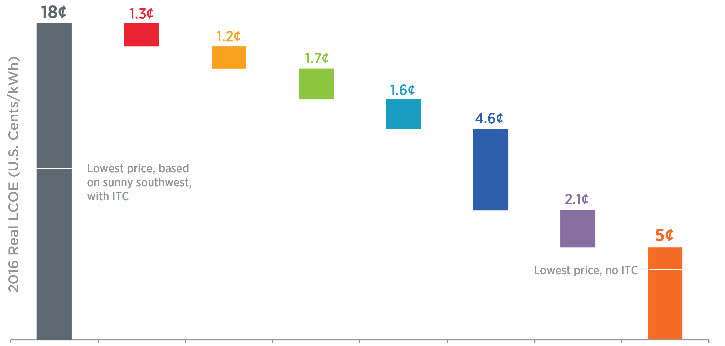
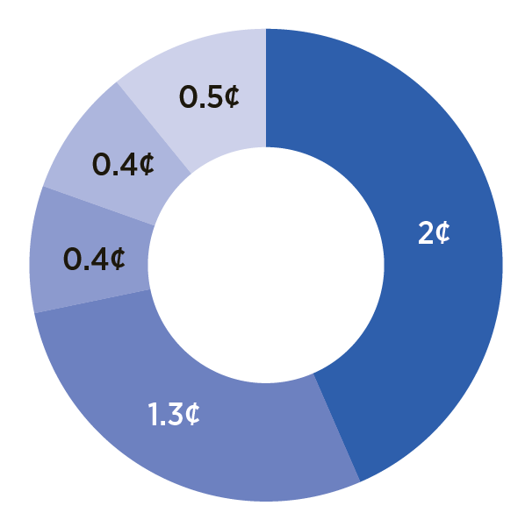
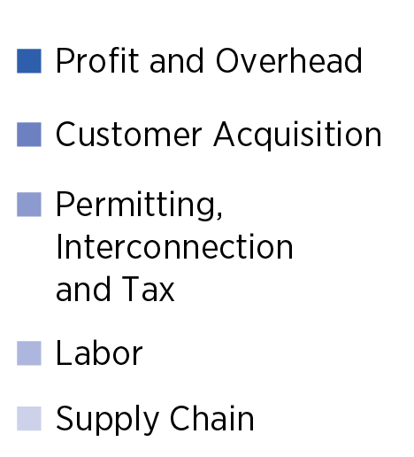
A Pathway To 5 Cents per kWh for Residential PV
2016
Benchmark
Improve Module Efficiency:
16% to 25%
Lower Sustainable Module Price:
$0.60 to $0.30/W
Improve Reliability:
0.75% to 0.2% per year, 30 Year Inverter Life, $20 to $7/kW-yr O&M
Reduce Hardware Costs:
$0.60 to
$0.20/W
Reduce Soft Costs:
$1.7 to $0.60/W
Obtain Lower Financing Rates:
7.5% to 6%
SunShot 2030
Residential
Goal
5.6 kw_{(dc)} residential systems with 1,470 kwh_{(ac)}/kw_{(dc)} first-year performance. Includes 5 year MACRS. 2016 ITC lines indicate low, median, and high U.S. solar resources.
Notes:
Although these targets are aggressive, multiple pathways toward achieving them are possible. Here we show one potential route, which relies on significant improvements in module price and efficiency, system reliability, O&M costs, hardware and labor costs, and financing rates. However, the numerous interdependencies and tradeoffs among cost- and performance-improvement factors create numerous potential approaches—all of which require sustained, multifaceted innovation.

